Slide 1



Capstone
Credit card fraud detection

Slide 2
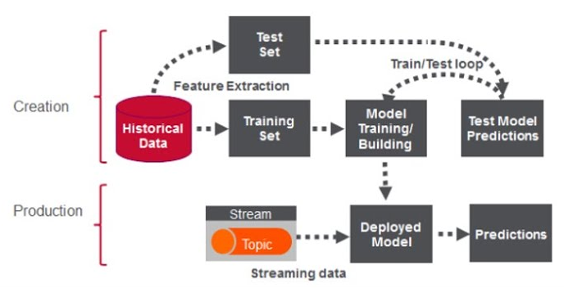
The plan

Slide 3

Cloud

Slide 4
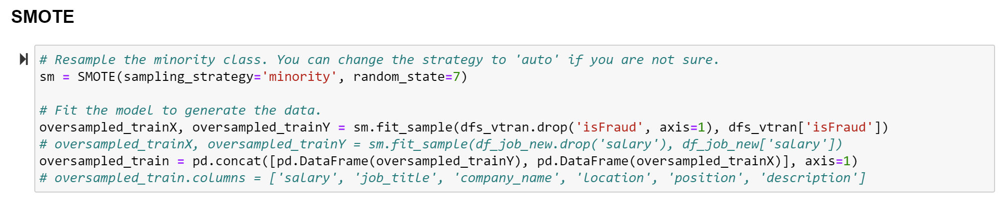
smote

Slide 5
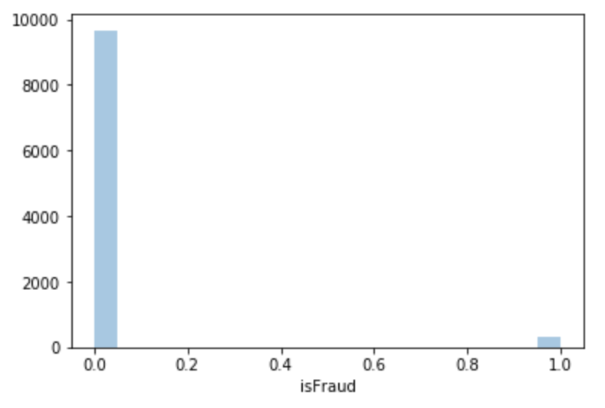
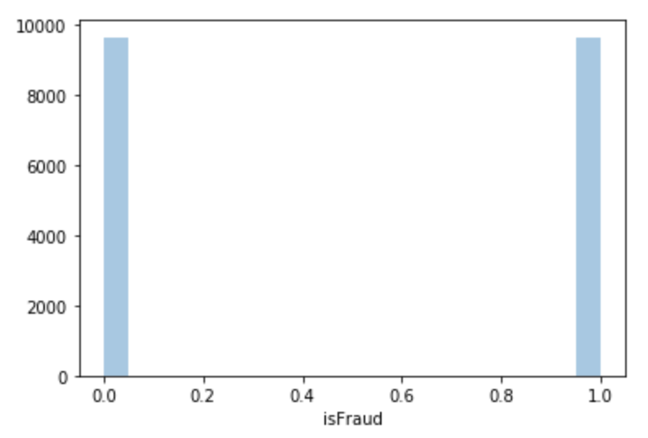
Target

Slide 6
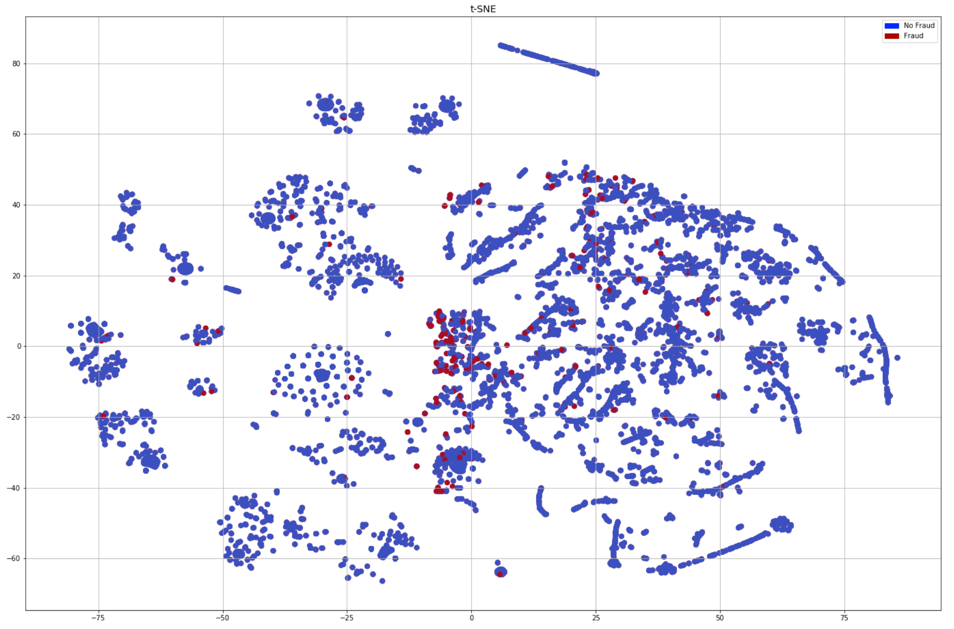
Before SMote

Slide 7
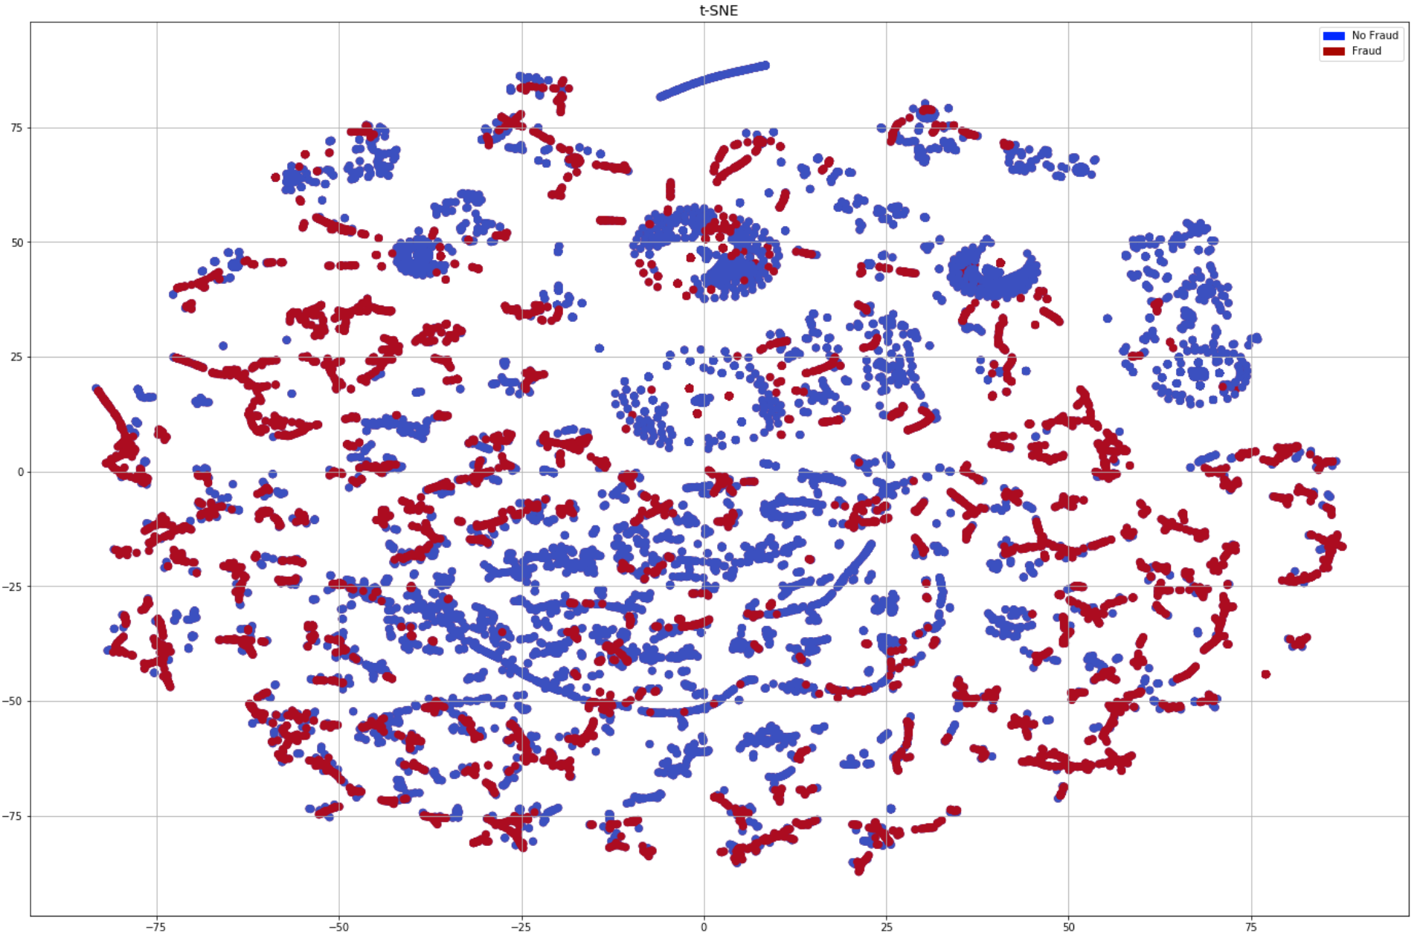
After smote
T-SNE

Slide 8
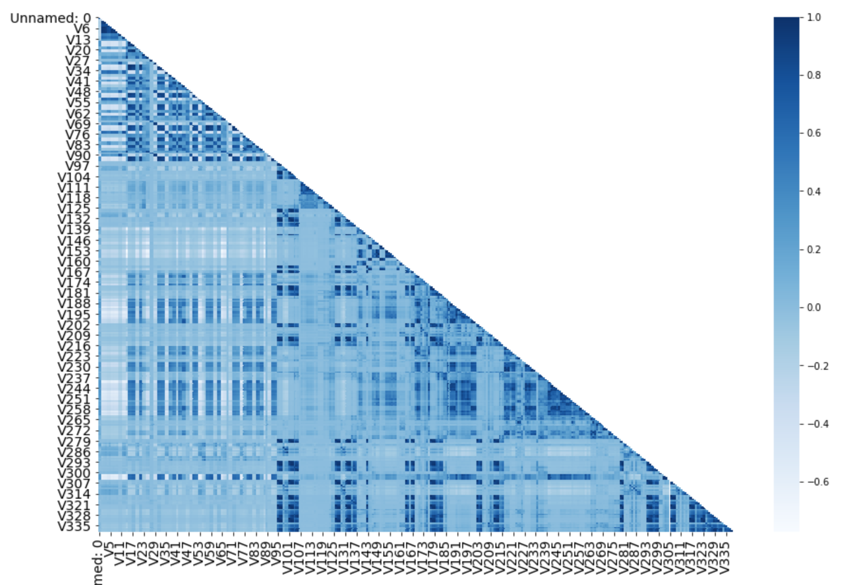
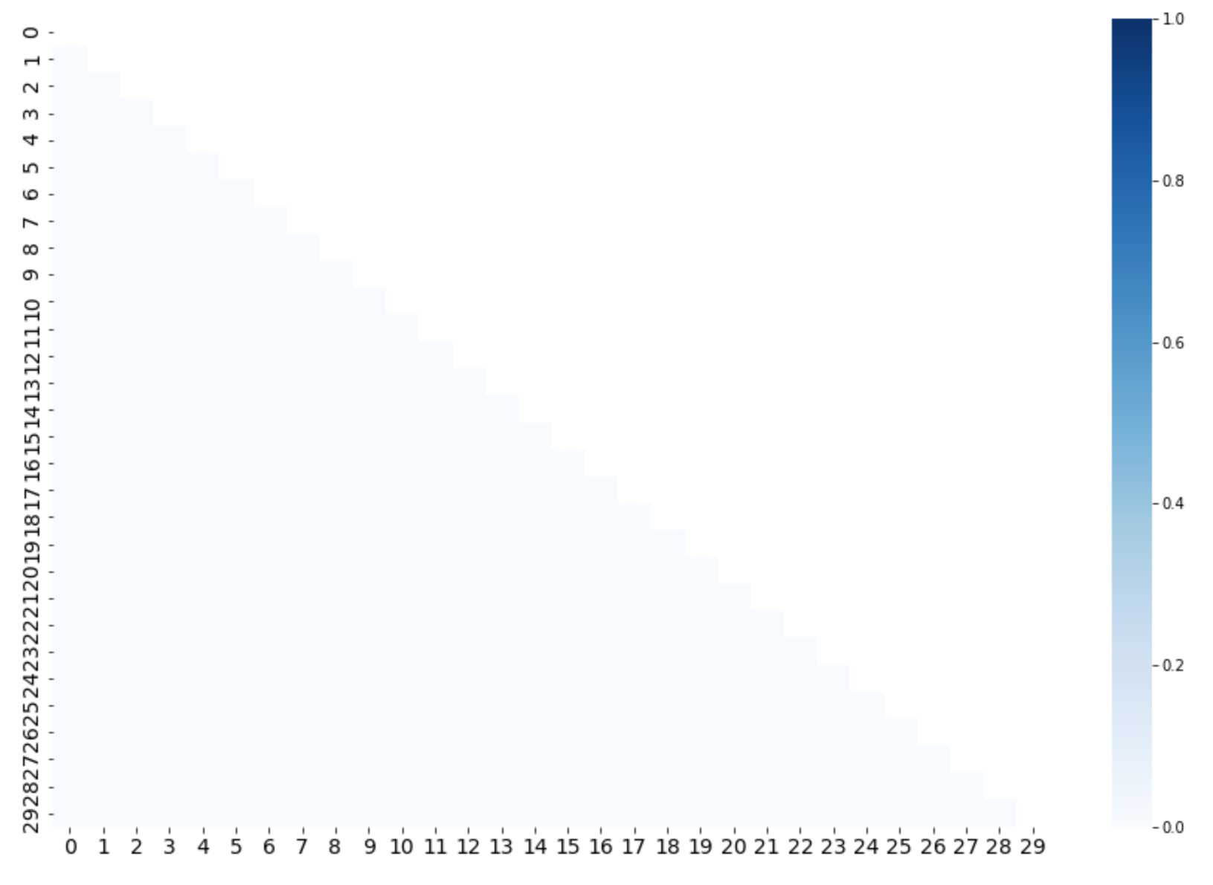
PCA

Slide 9
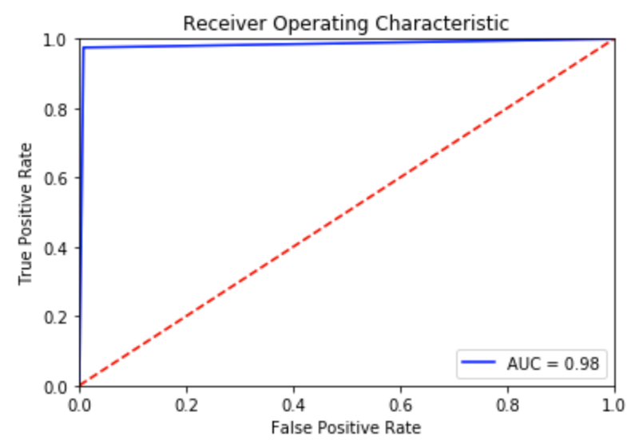
ROC

Slide 10
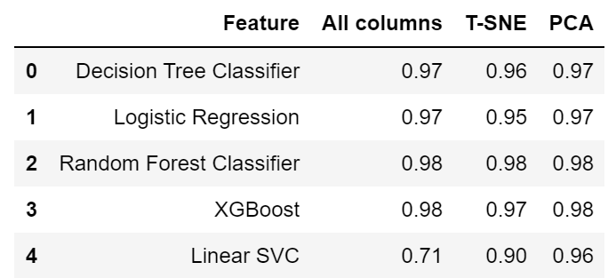
models

Slide 11
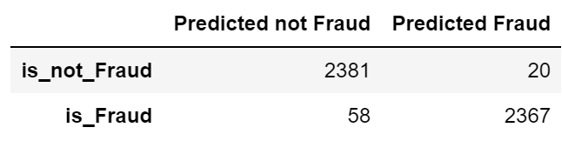
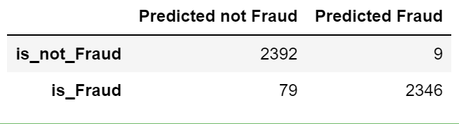
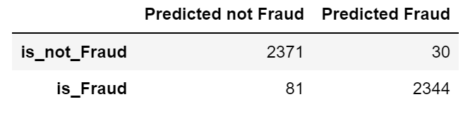
Confusion matrix
All columns
T-SNE
PCA

Slide 12
What’s next?
Group V columns to avoid overfit
1
Add transaction date
2
Consider to include C and D columns
3
Implement the model in Postgres
4

Slide 13

Thank you

